Slide 1
LHL Final Project by Zeynab Akolade

Slide 2




Background
Experience in banking.
Arsenal fan by association.
Love photography and research.
Always solution driven.

Slide 3
Problem Statement
"Despite telecom providers' ongoing efforts, customer churn in the telecommunication industry remains a persistent challenge, resulting in financial losses and reduced satisfaction."

Slide 4



Project Objective
Analyze telecom providers customer churn and understand why customers leave.
Train a machine learning model to identify key factors influencing customer churn.
Select the most reliable model to assign churn probabilities, streamlining customer service efforts to reduce churn.

Slide 5
There is a total 243553 records and 14 columns available in the dataset. Out of 14 columns there are 9 numerical columns and 5 categorical columns.
Project Analysis
Logistic regression
Decision tree
Random Forest
Using several model techniques

Slide 6
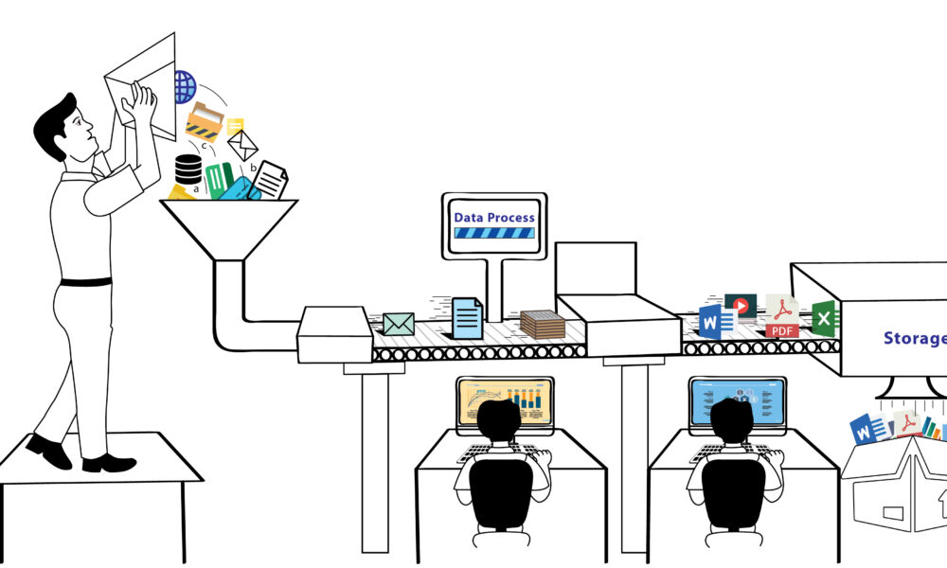


Process & Accomplishment
Data gathering and preprocessing
Feature engineering
Various regression models for insights
Random Forest

Slide 7
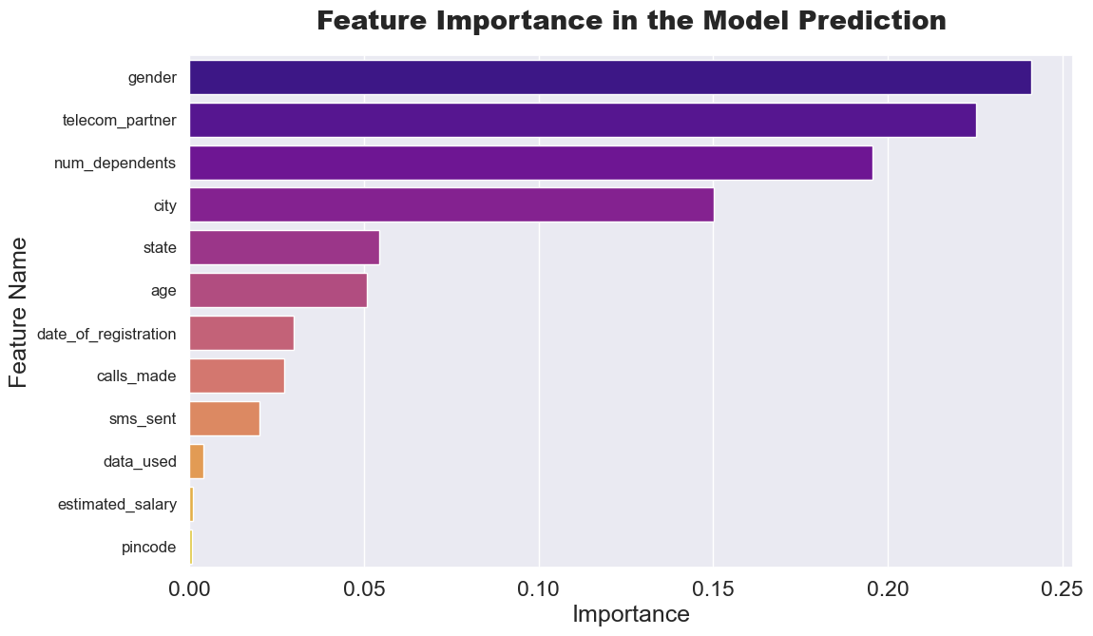

Results
Based on the analysis the main factors affecting customer churn includes gender, telecom_partner, num_dependents, location, and age.
Identifying this pattern allows telecom providers to proactively retain customers and improve satisfaction by addressing these factors.

Slide 8
Final thoughts
Data sourcing could be a challenge when doing industry analysis.
Model can still be improved and deployed for various situations.
Applying other predictive models in the future will be great for deep learning.

Slide 9


Thank you.
LinkedIn/Zeynab Akolade
https://github.com/zoakolade

